Slide 1
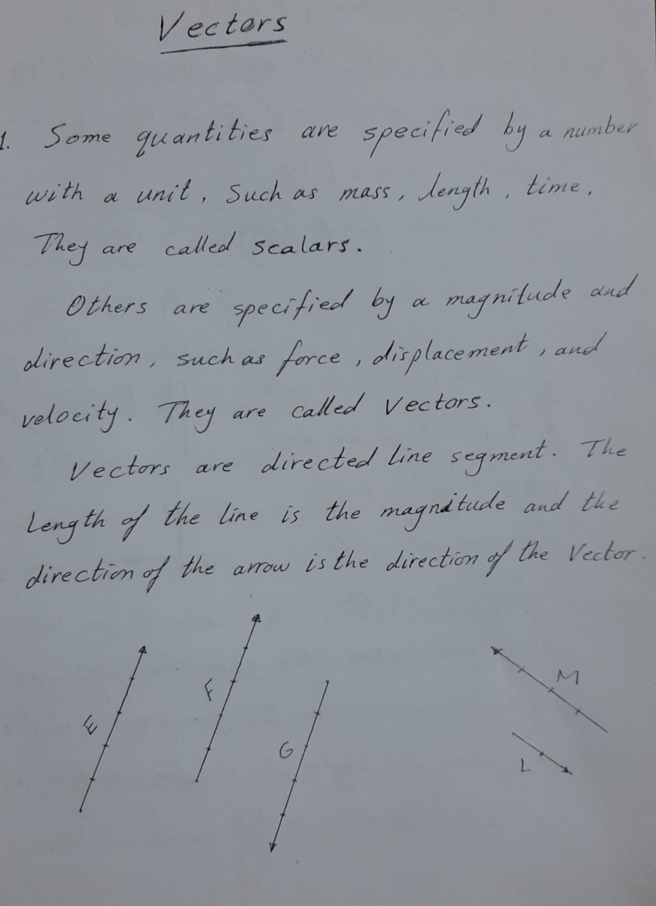
Scanned with Fast Scan

Slide 2
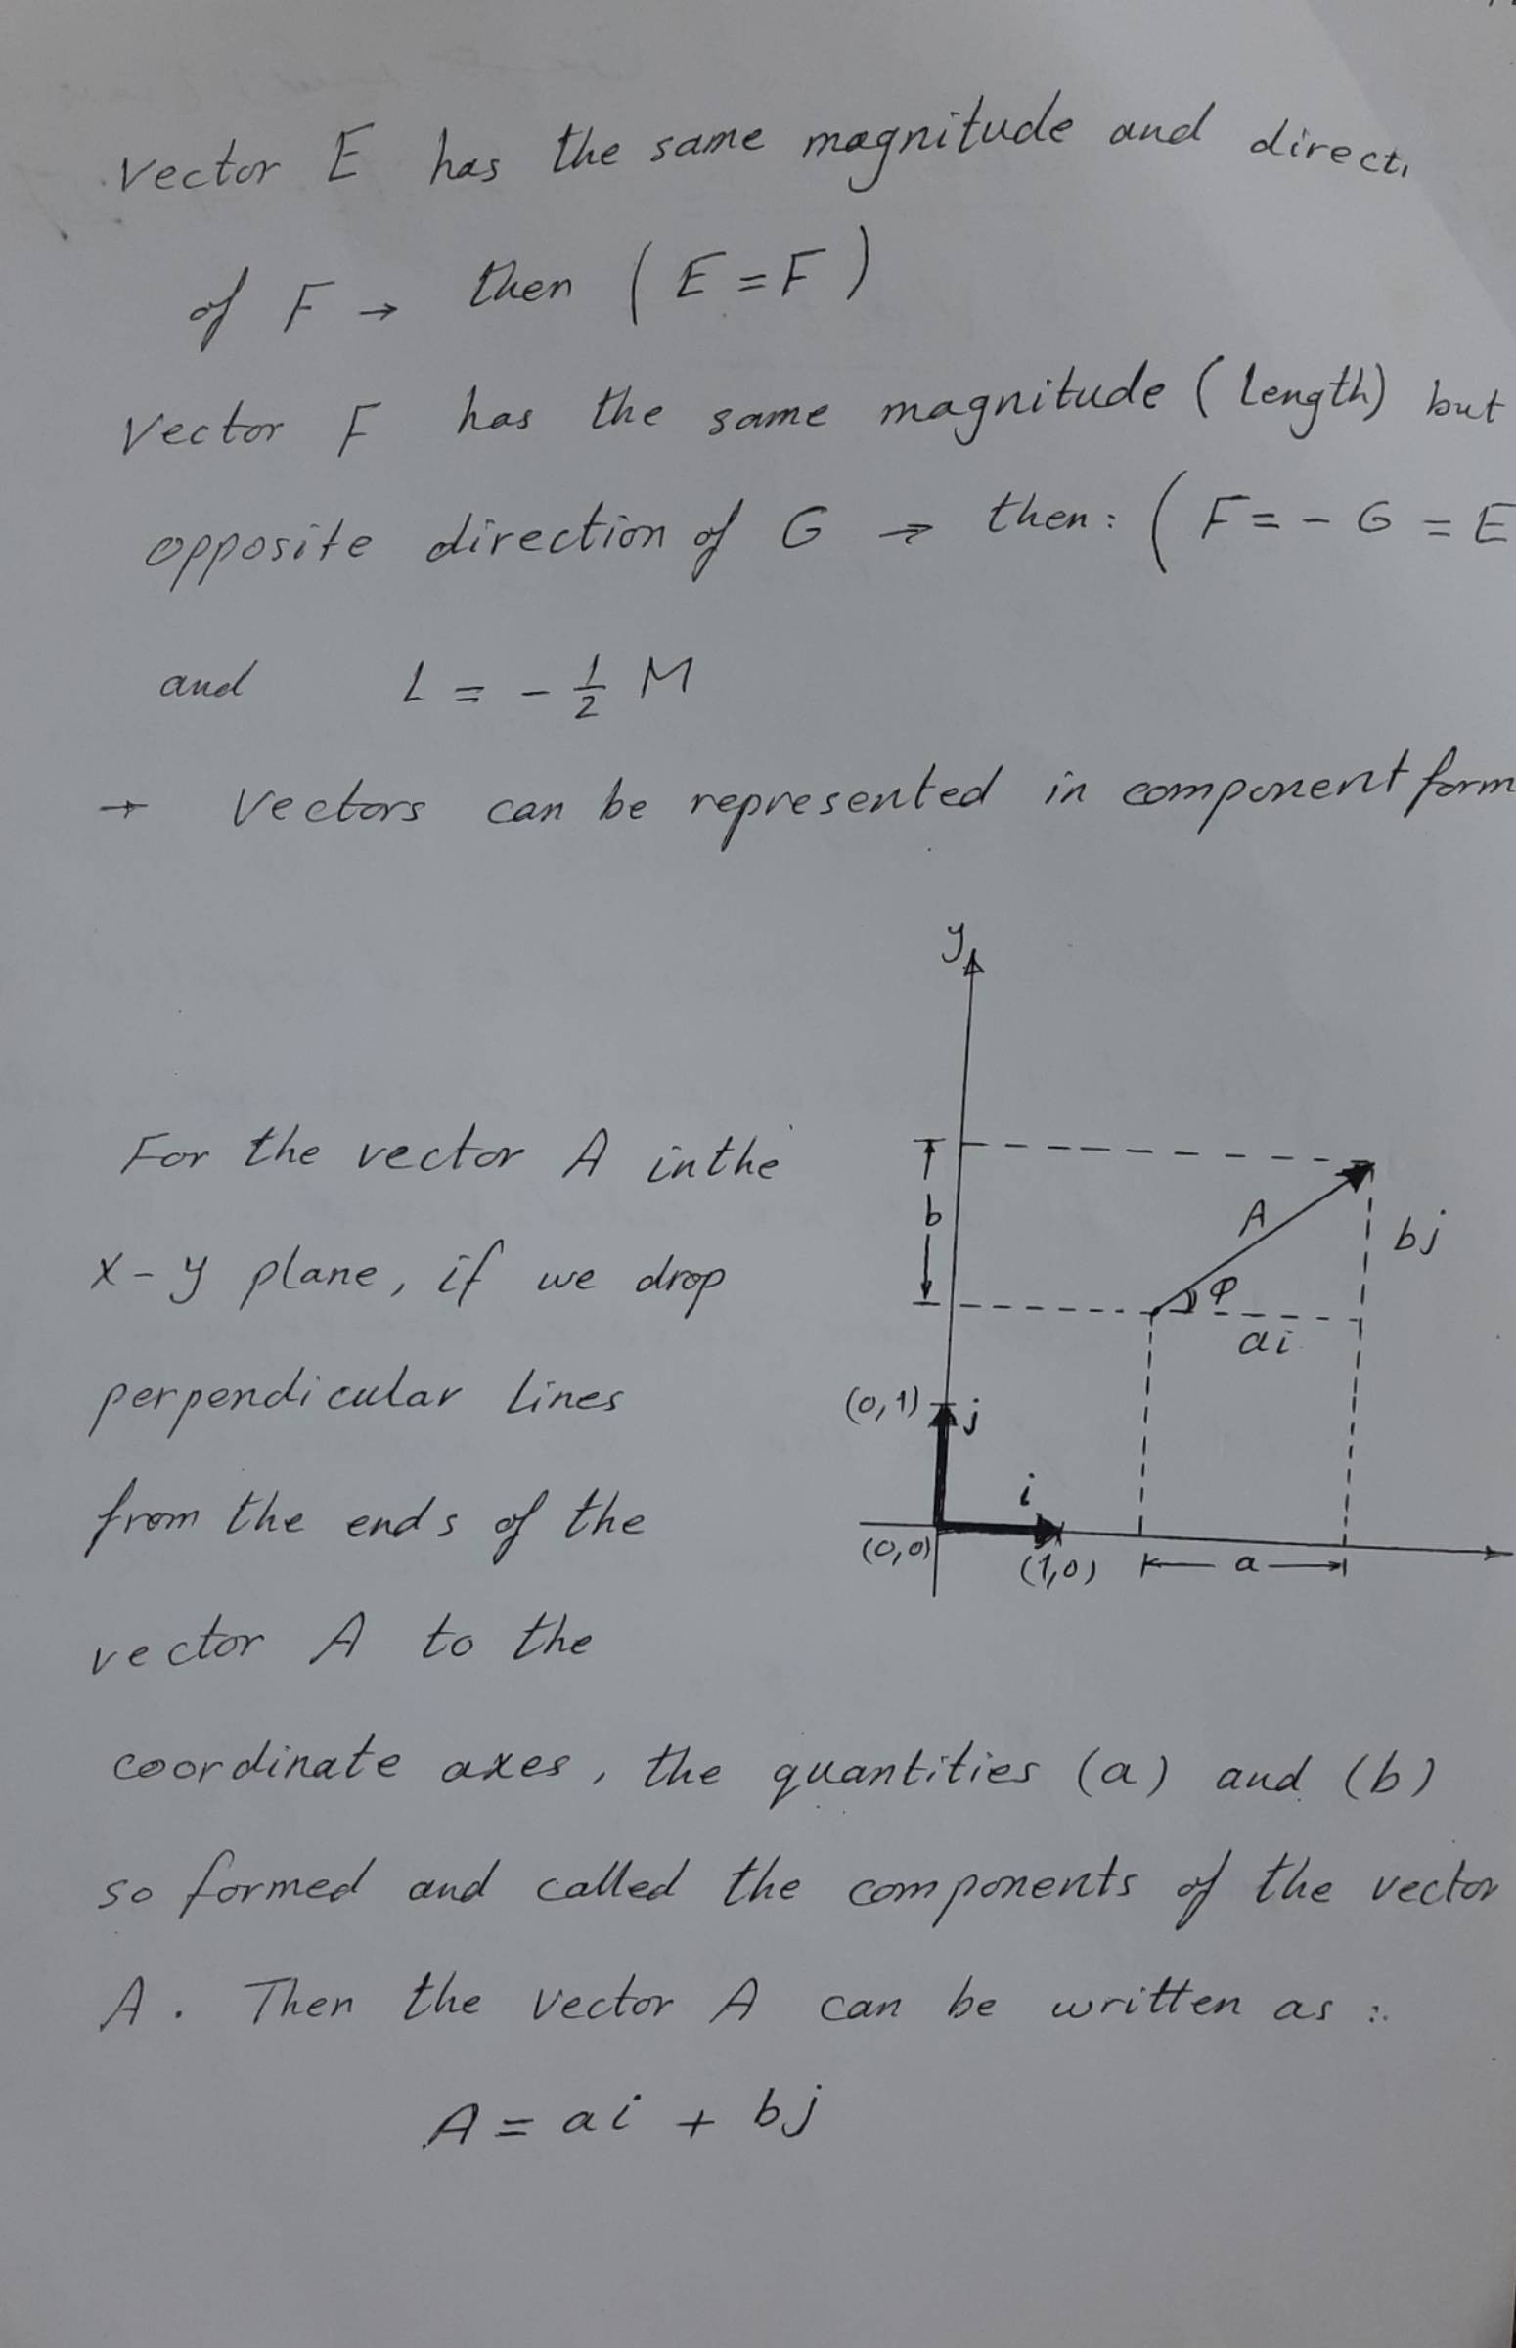
Scanned with Fast Scan

Slide 3
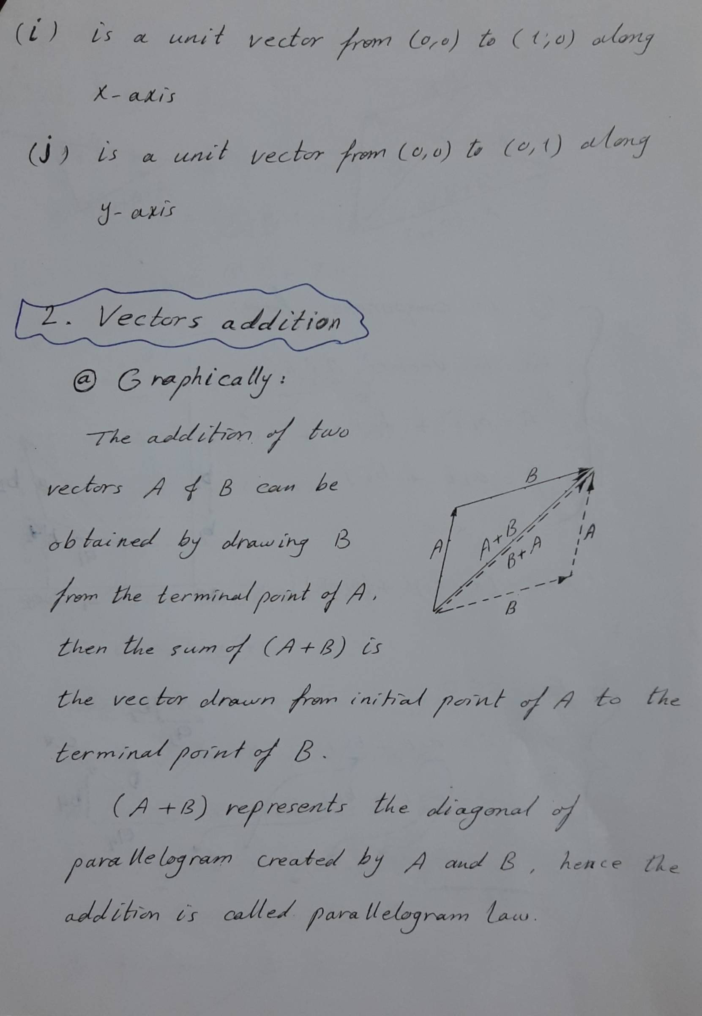
Scanned with Fast Scan

Slide 4
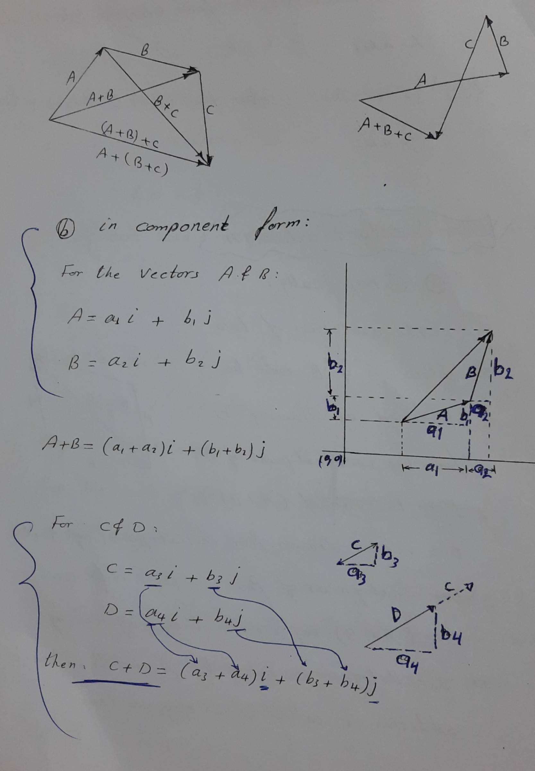
Scanned with Fast Scan

Slide 5
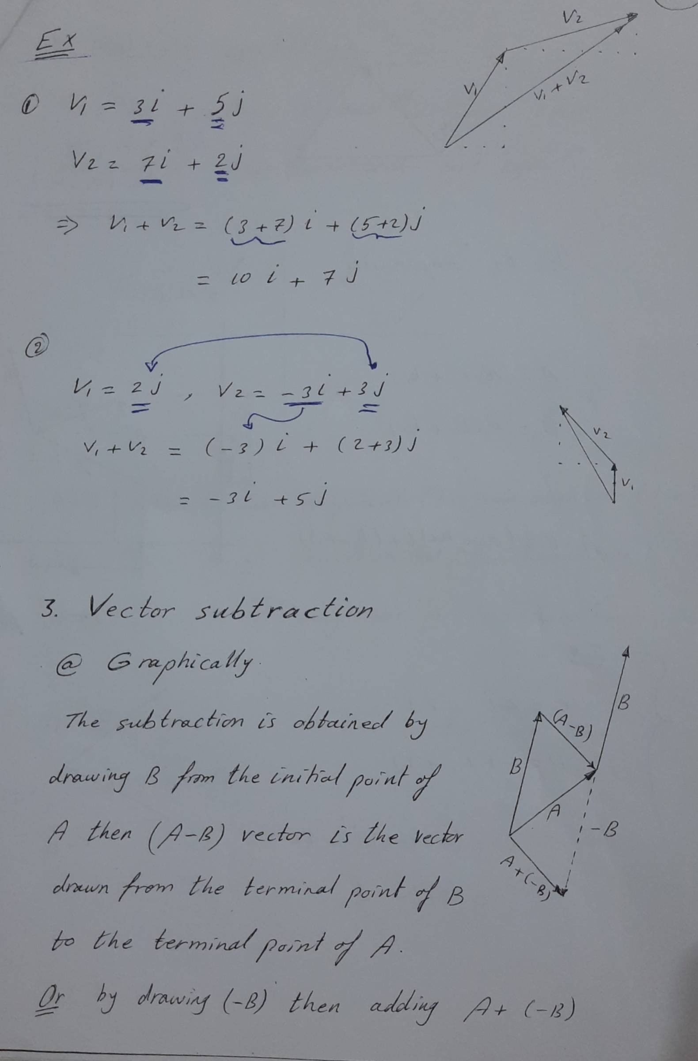
Scanned with Fast Scan

Slide 6
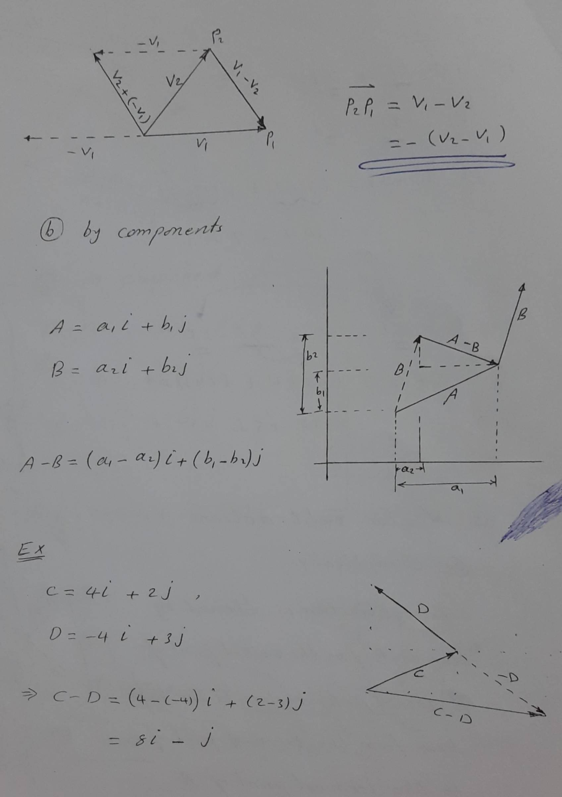
Scanned with Fast Scan

Slide 7
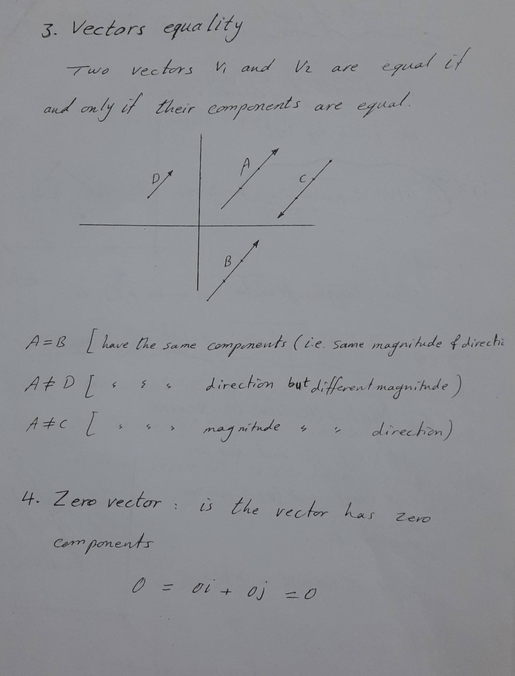
Scanned with Fast Scan

Slide 8
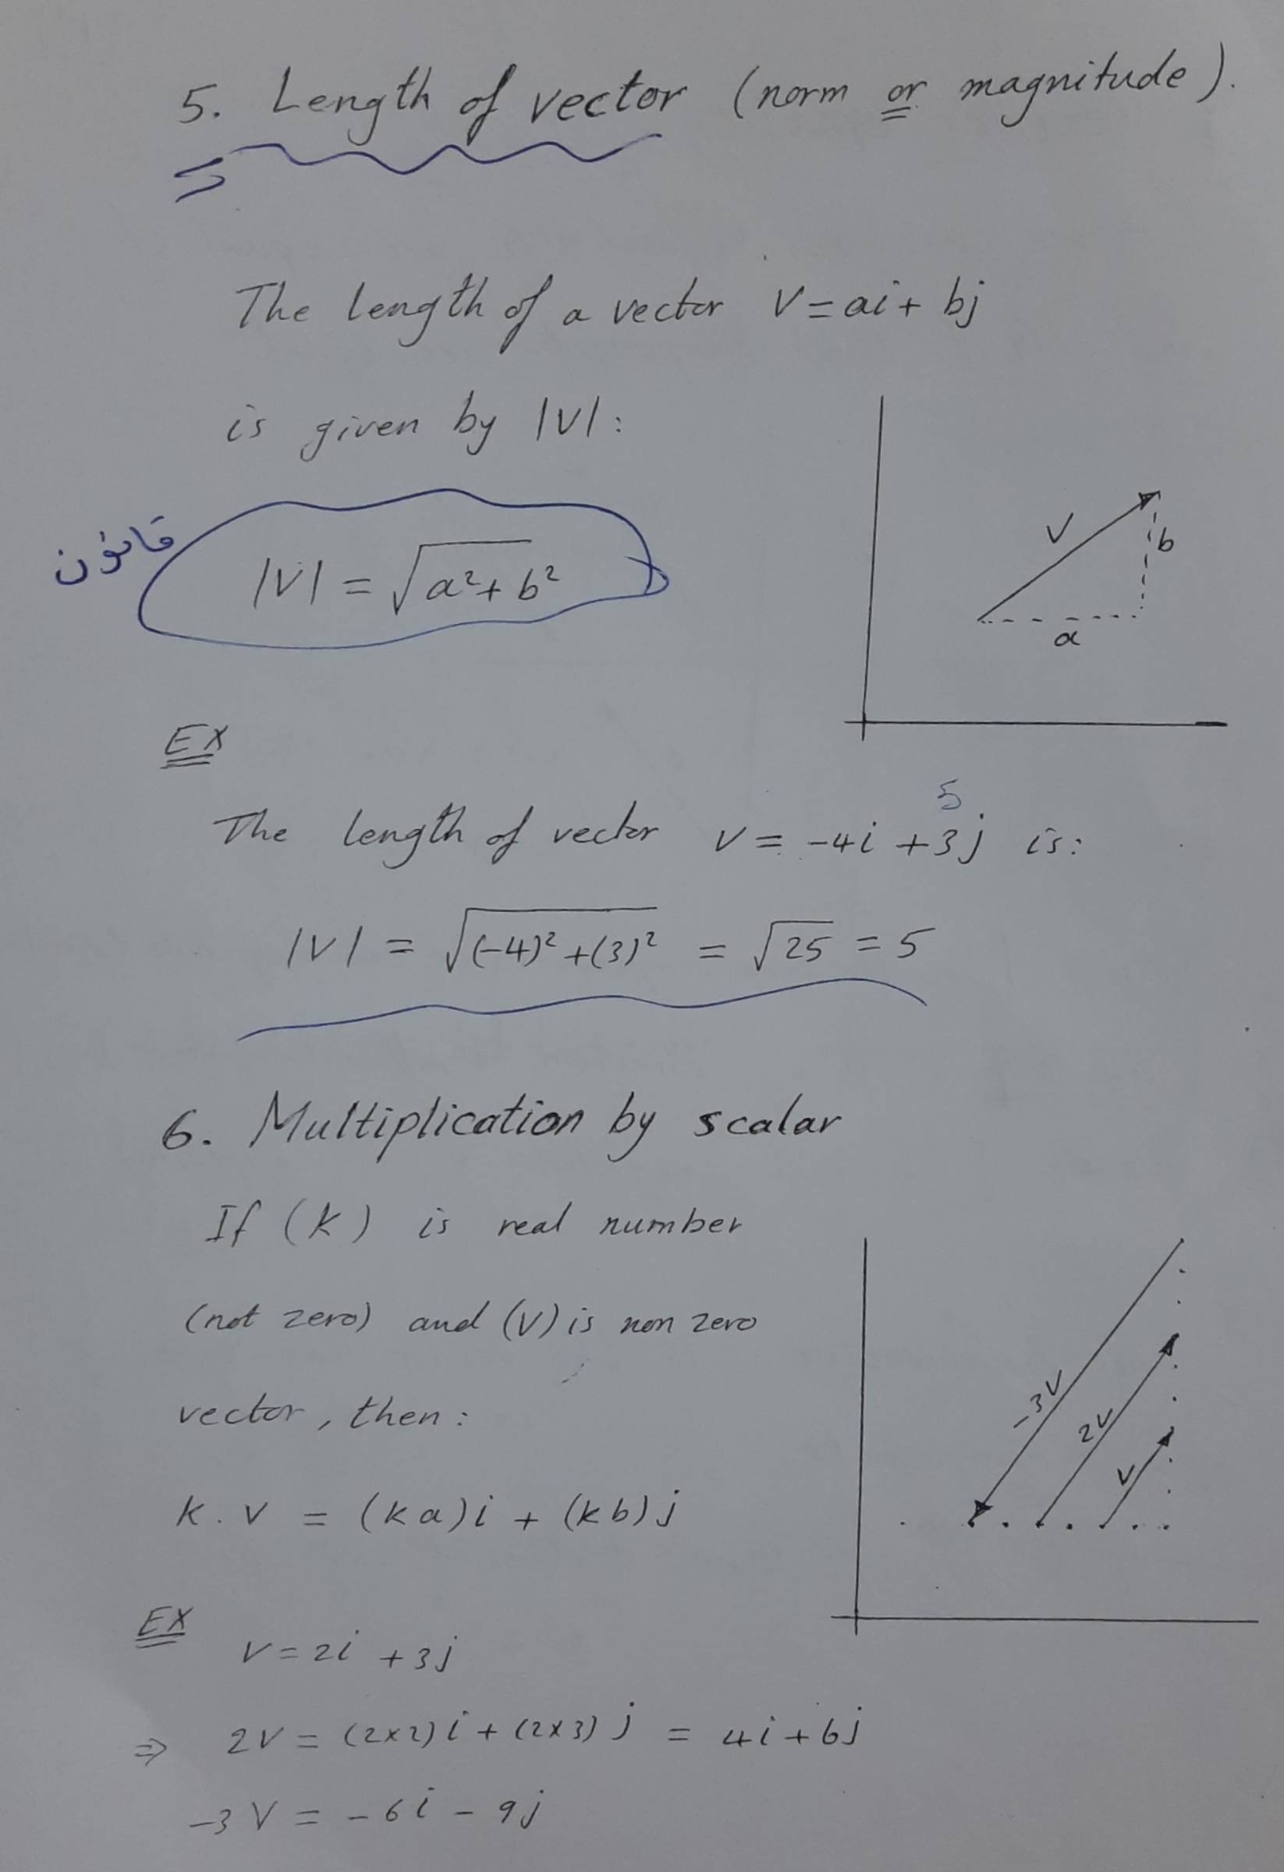
Scanned with Fast Scan

Slide 9
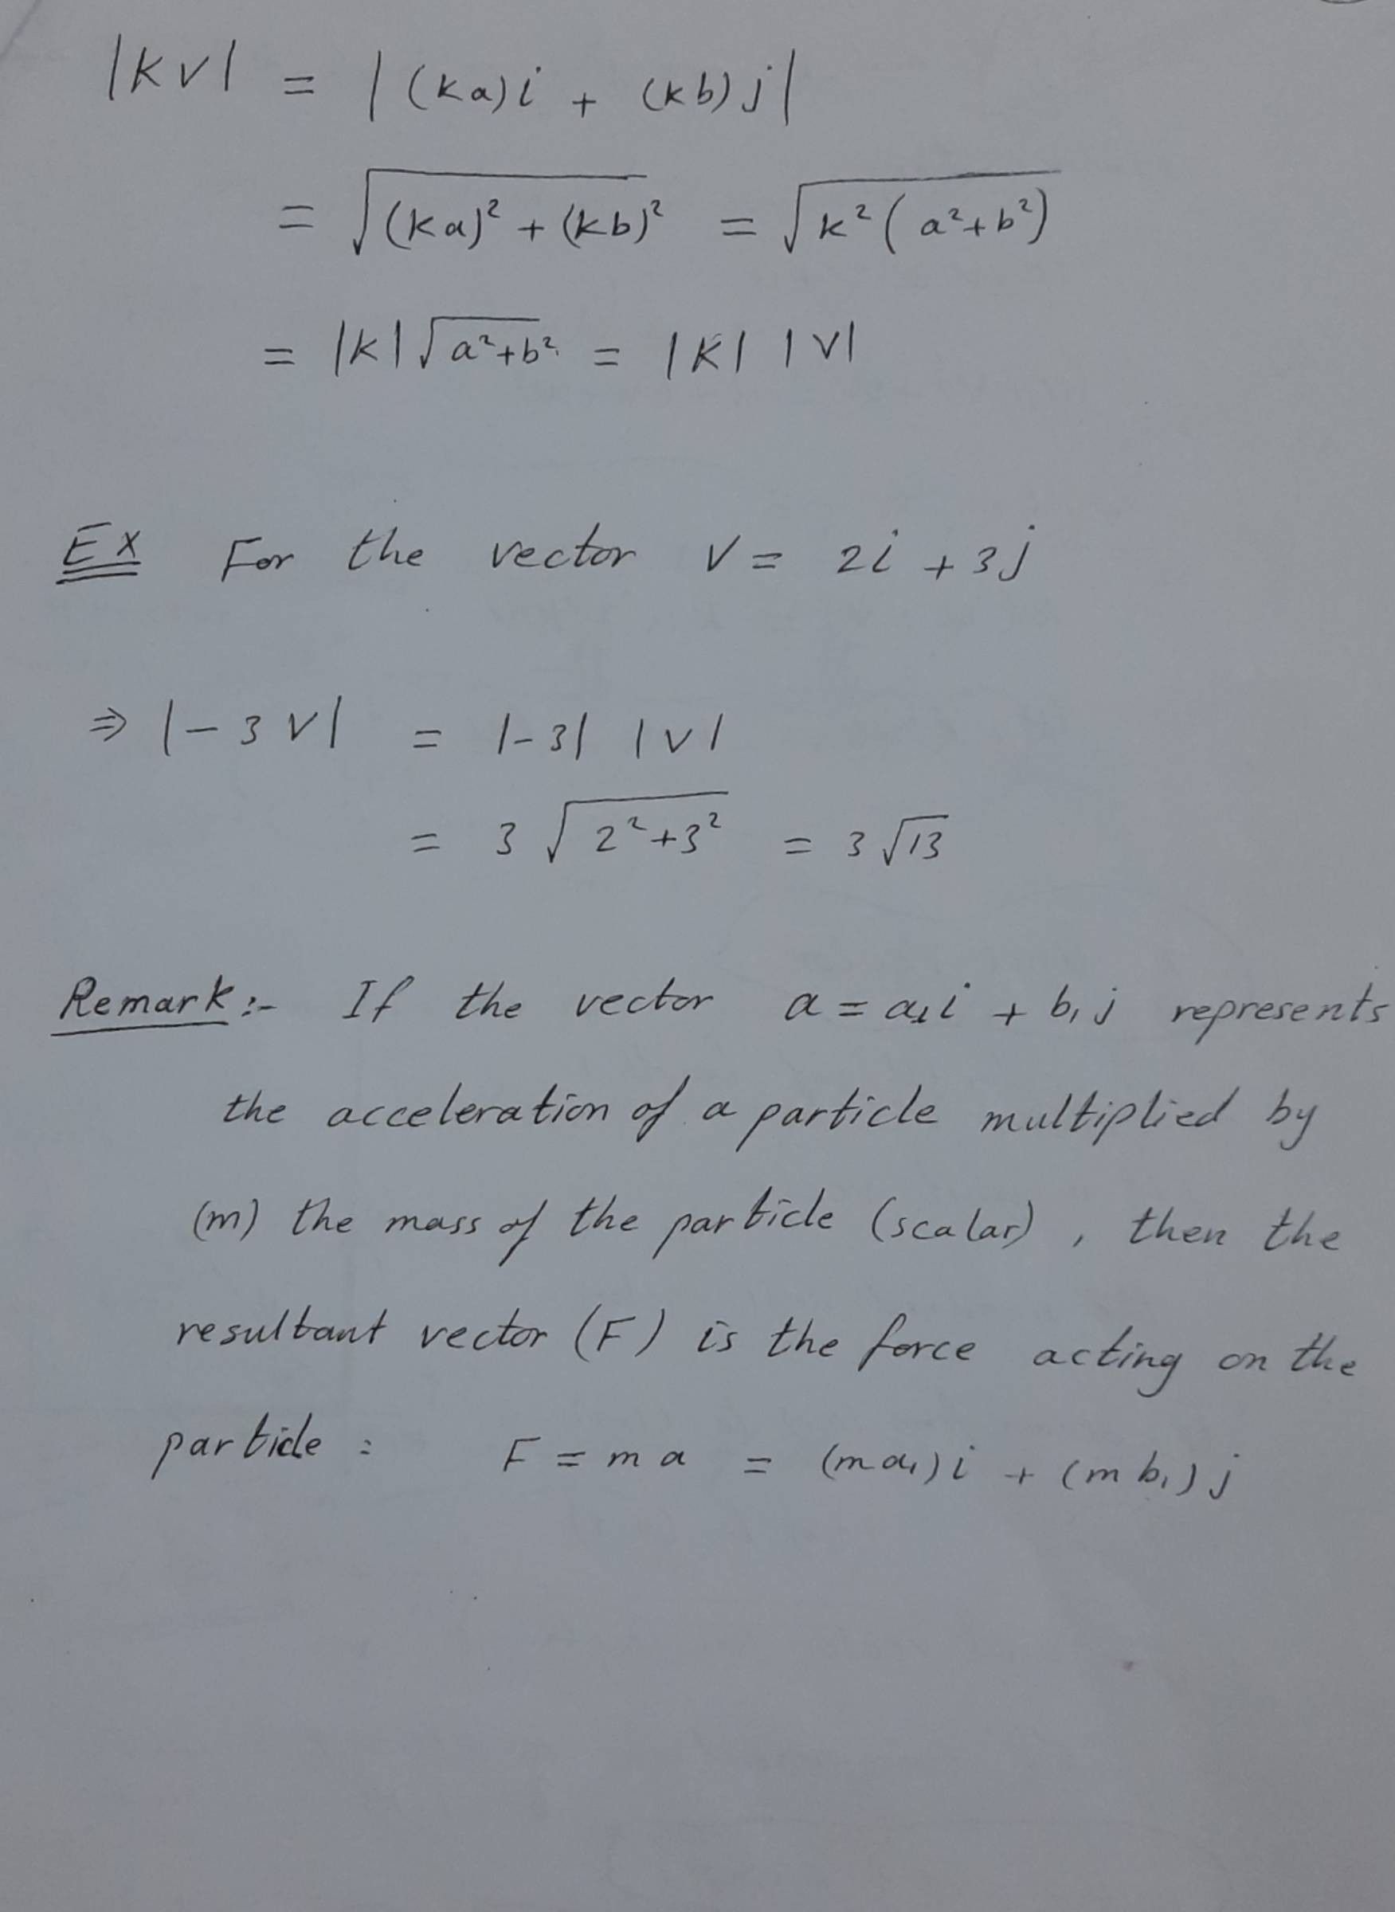
Scanned with Fast Scan

Slide 10
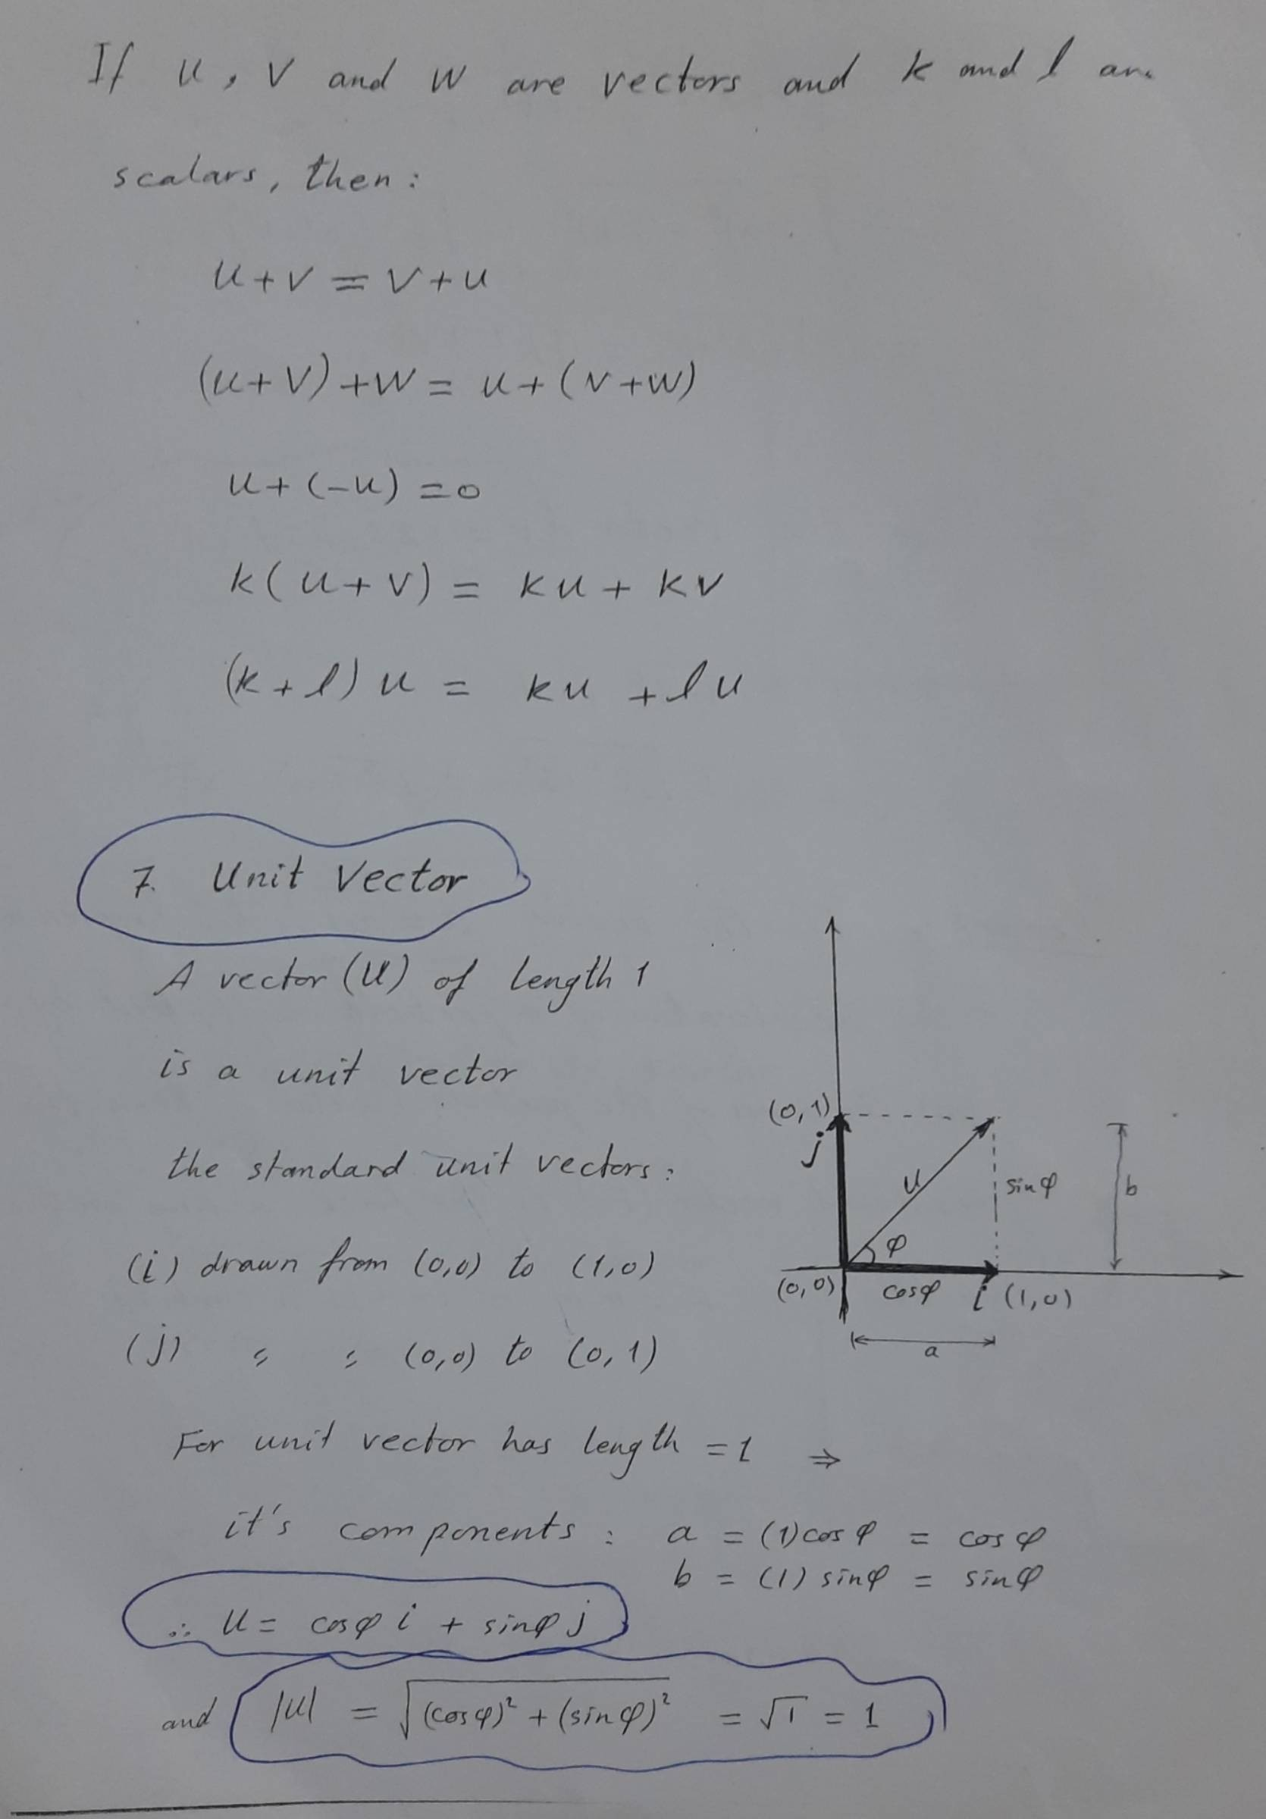
Scanned with Fast Scan

Slide 11
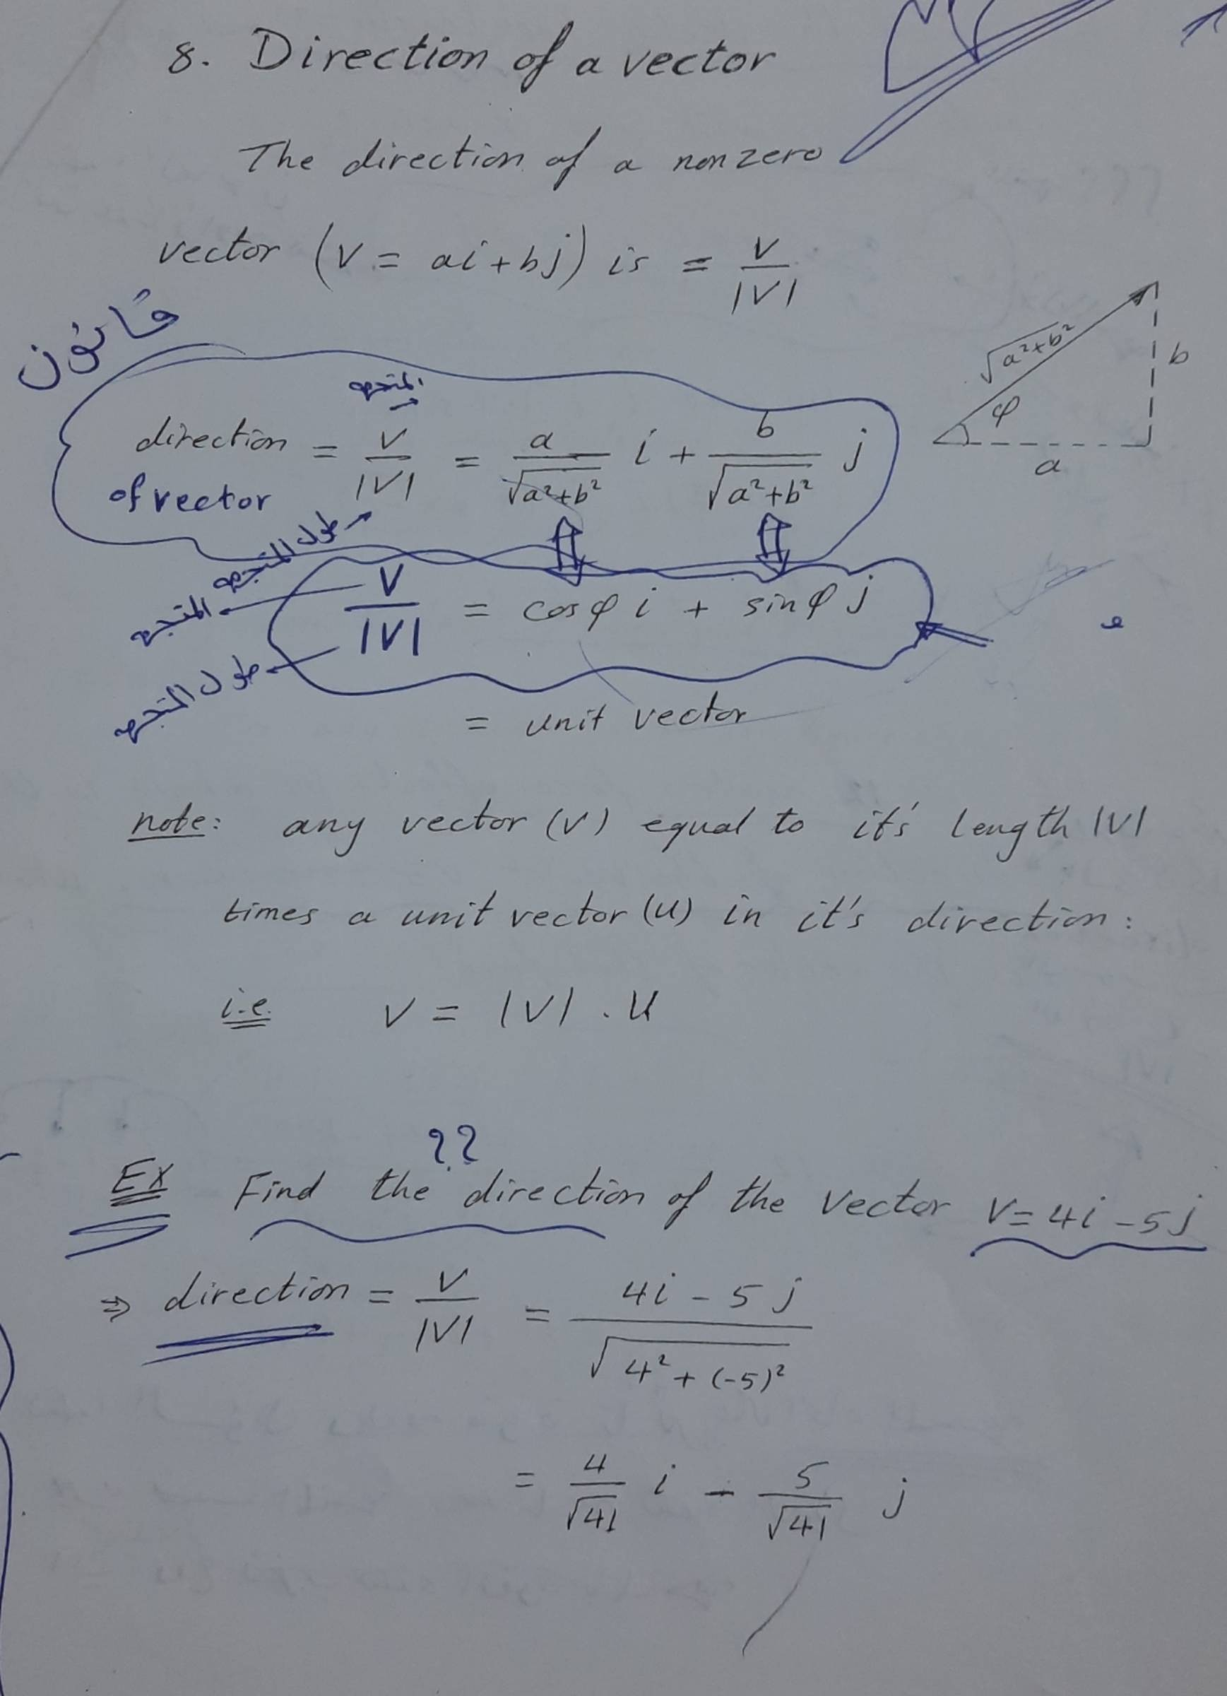
Scanned with Fast Scan

Slide 12
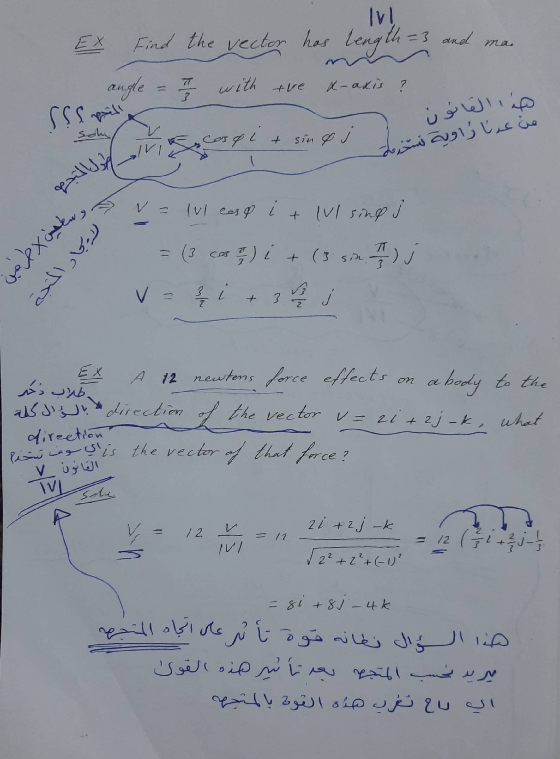
Scanned with Fast Scan

Slide 13
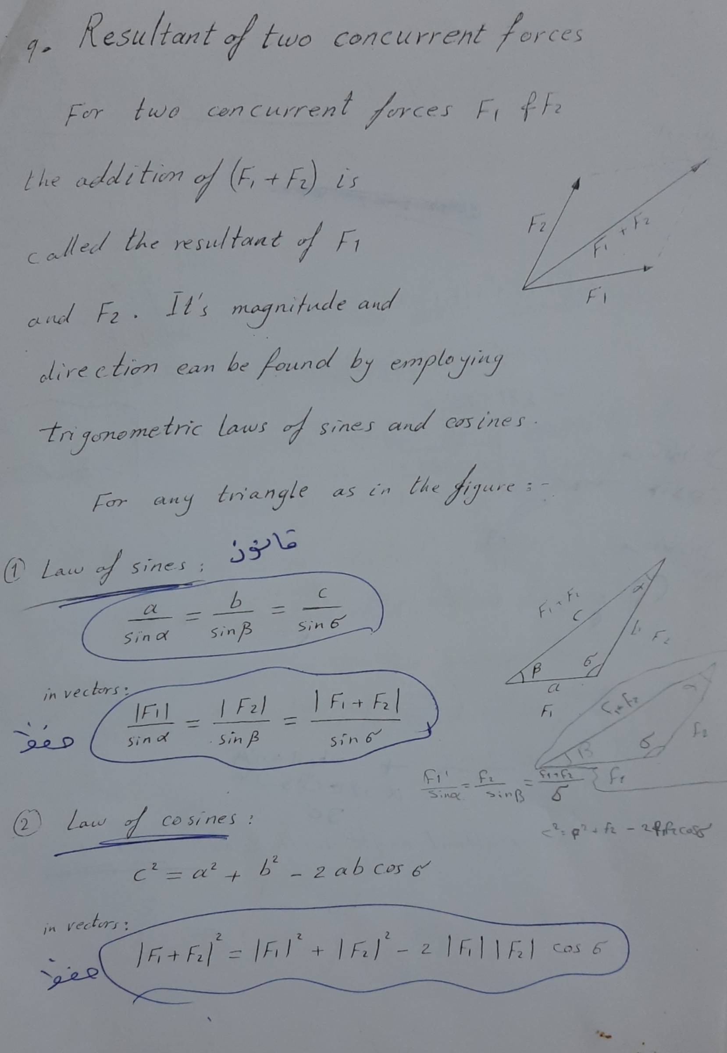
Scanned with Fast Scan

Slide 14
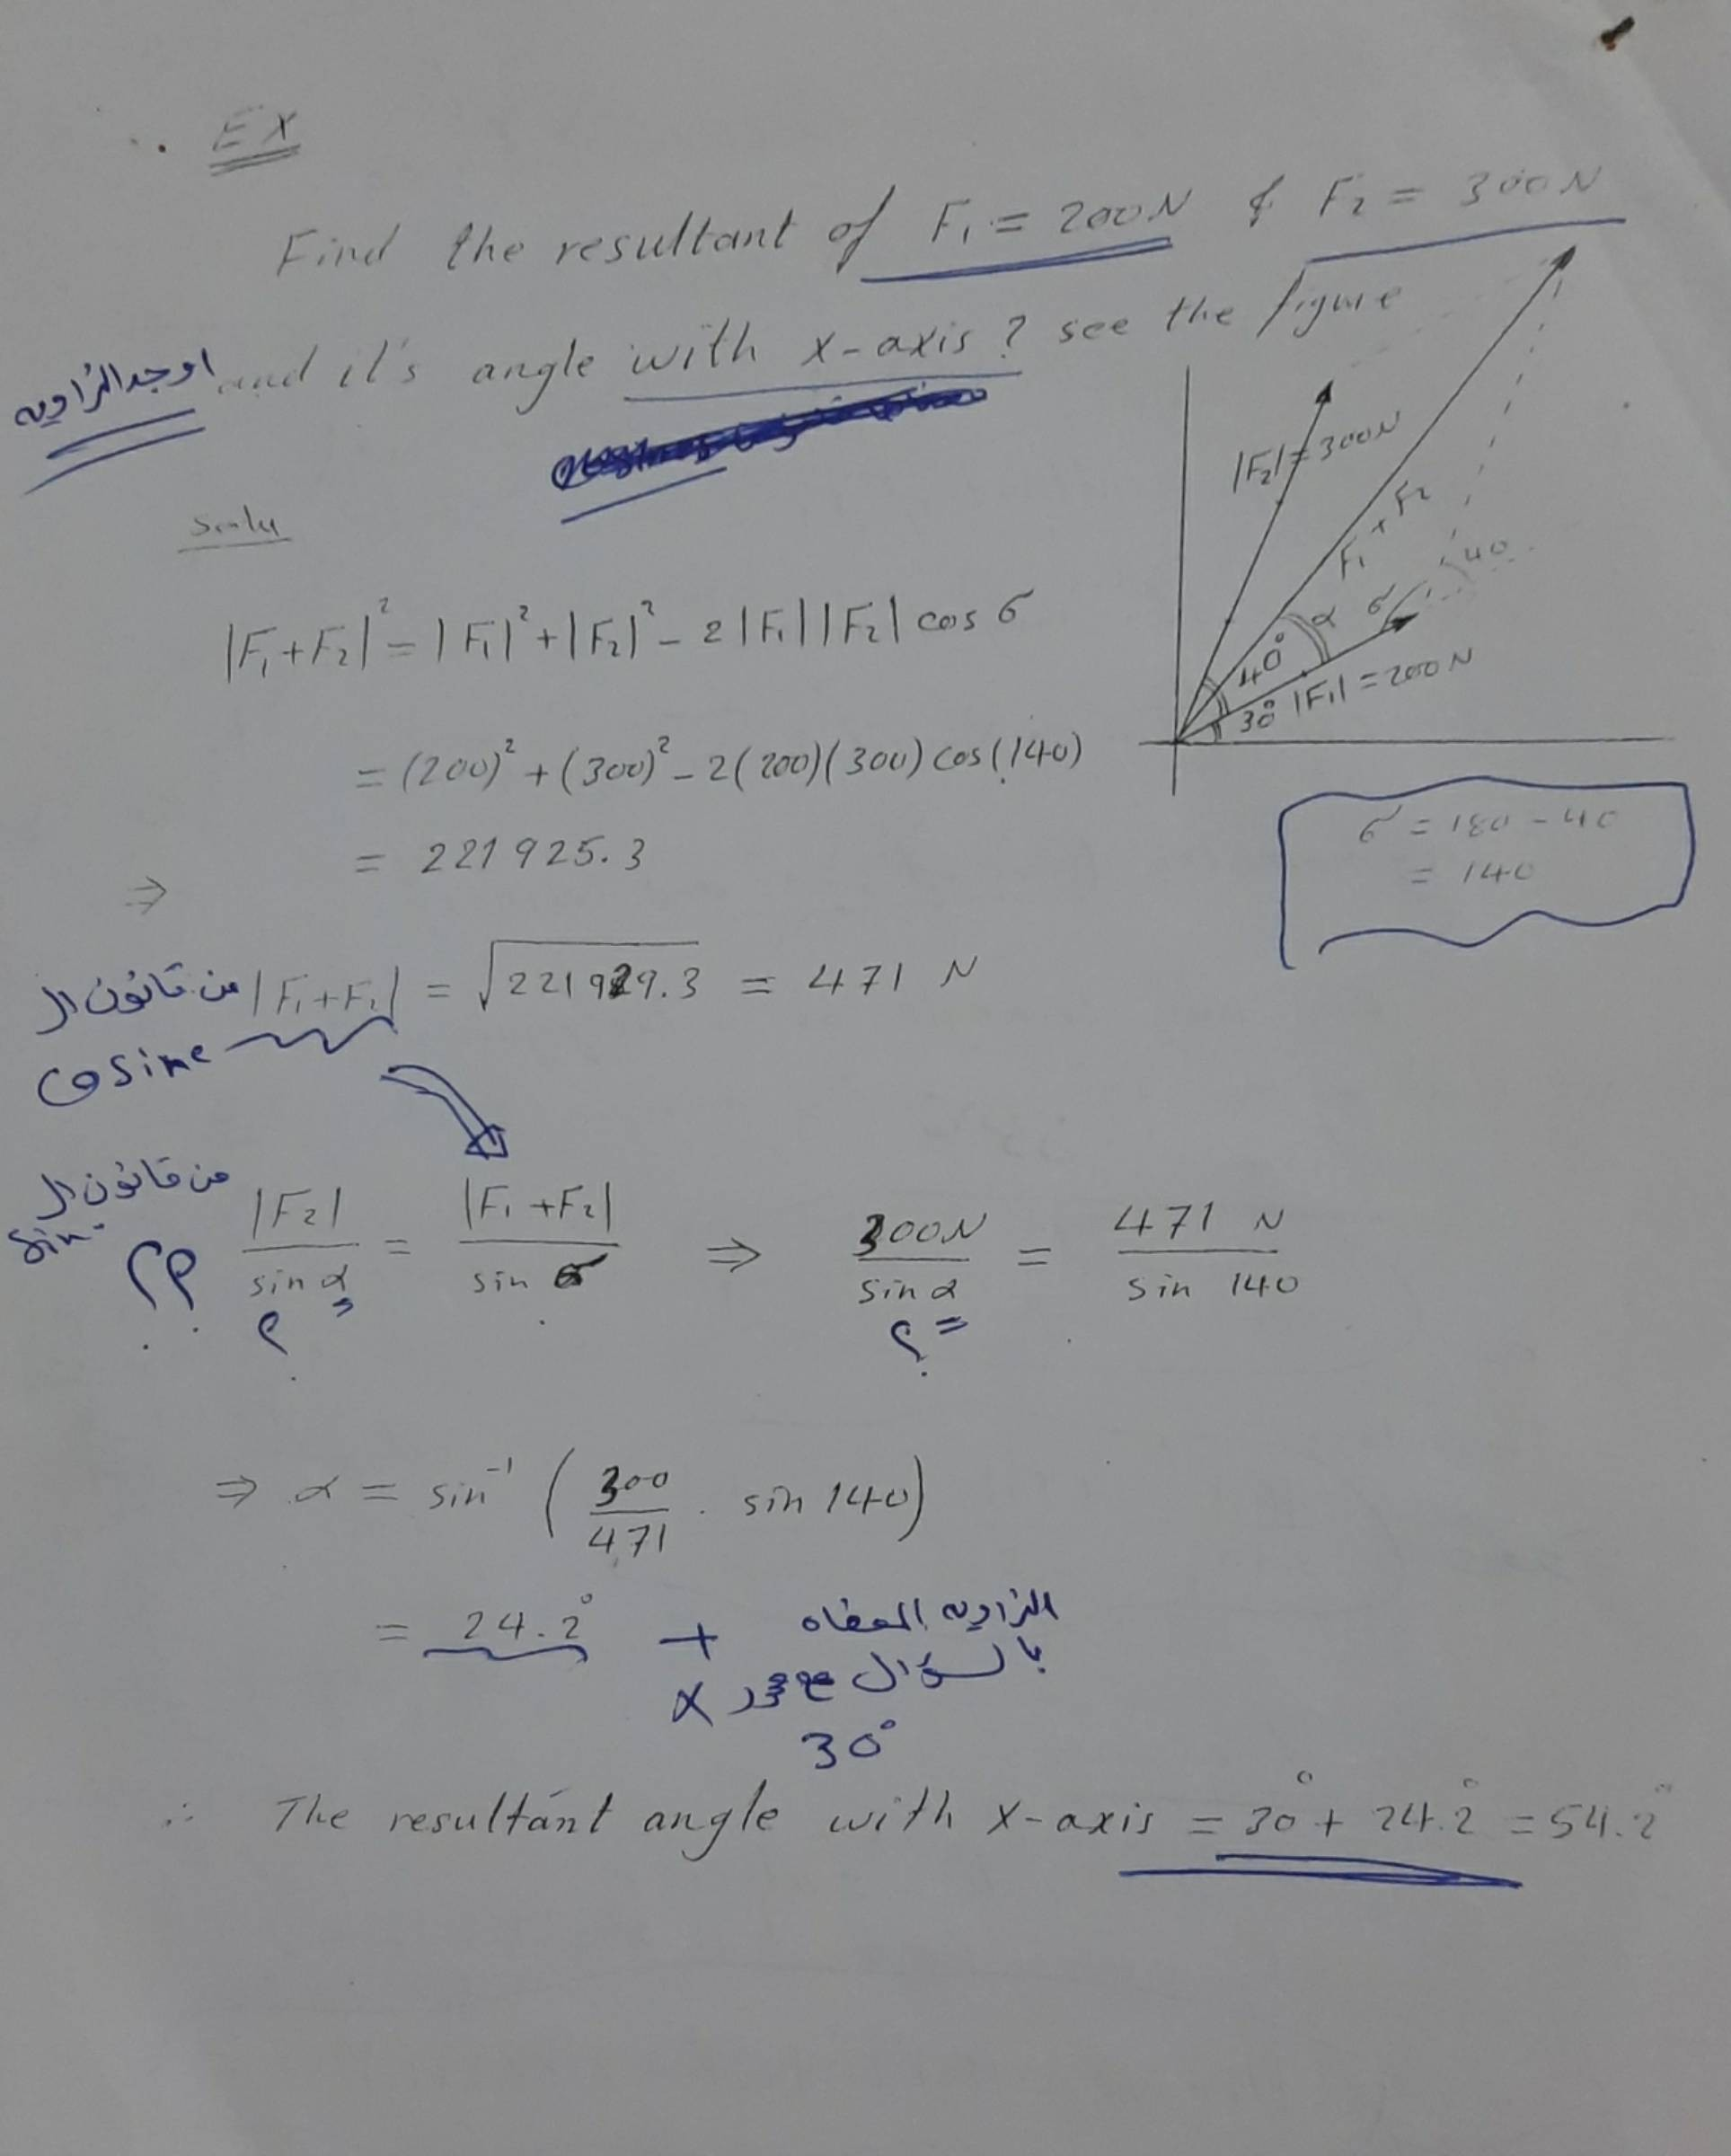
Scanned with Fast Scan

